Slide 1
Data Flows-
Hospital Admission File

Slide 2
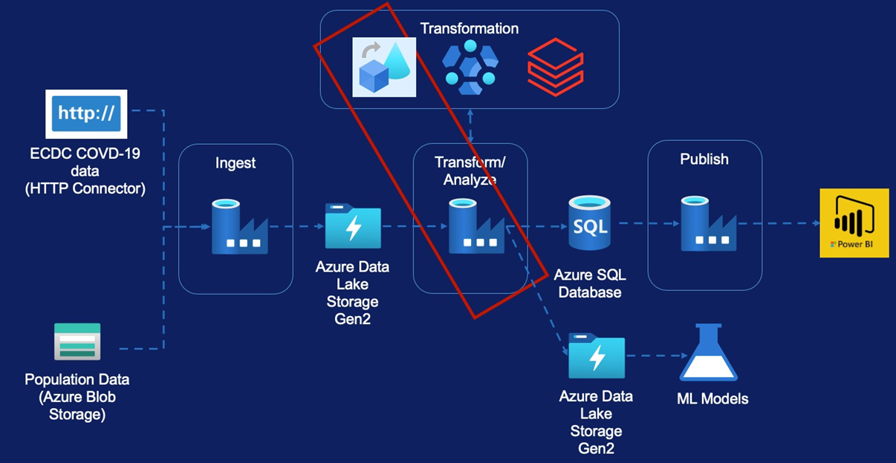
Data Flow-Case &Death Data
Requirement
Source Transformation
Select Transformation
Lookup Transformation
Pivot Transformation
Sink Transformation
Conditional Split Transformation
Derived Column Transformation
Aggregate Transformation
Sort Transformation
Join Transformation
Create Pipeline

Slide 3
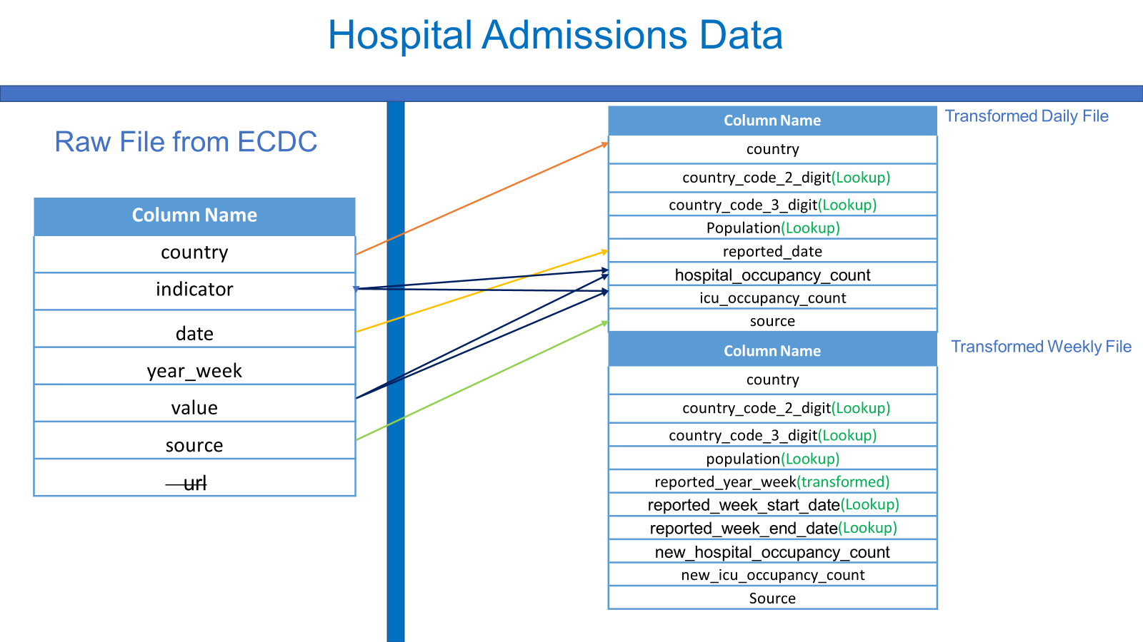

Slide 4
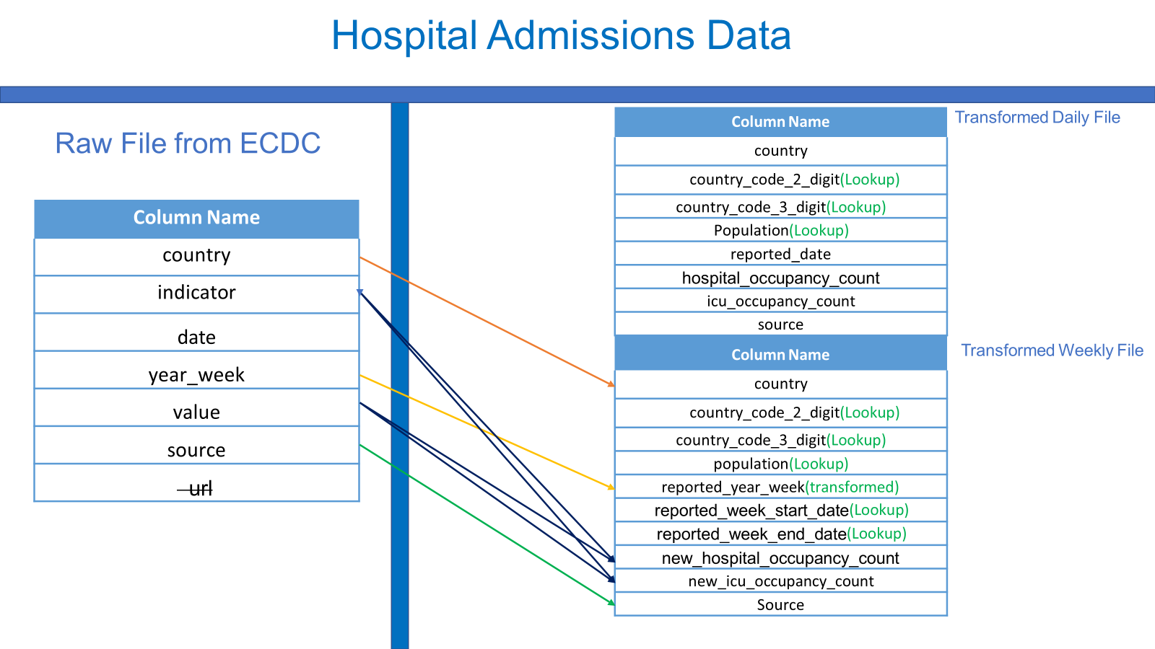

Slide 5
Source Transformation Data

Slide 6
Select Transformation
Assignment
Remove url
Rename date to reported_date
Rename year_week to reported_year_week

Slide 7
Lookup Transformation
Assignment
Lookup country file
Select only required fields (i.e. remove additional fields from lookup

Slide 8
Pivot Transformation

Slide 11
Select & Sink Transformation

Slide 14
Data Flow Execution

